Slide 1
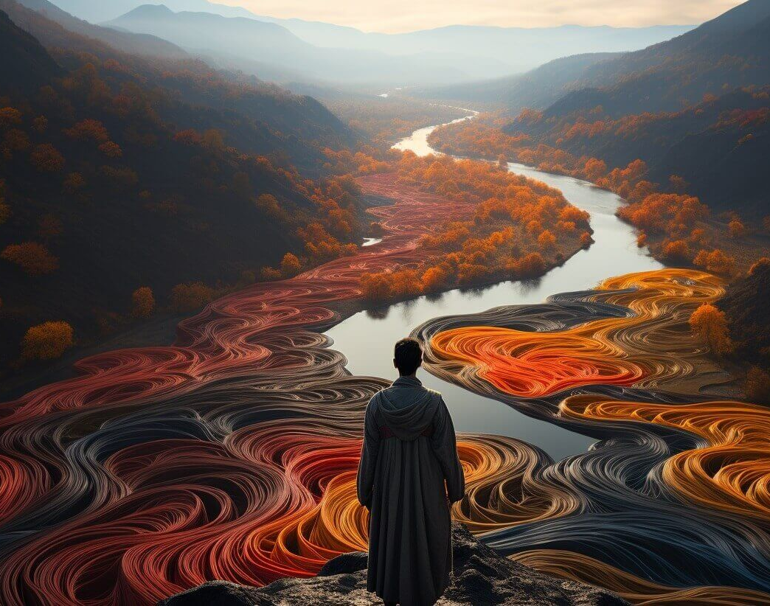
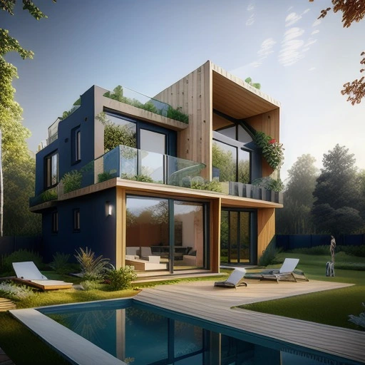
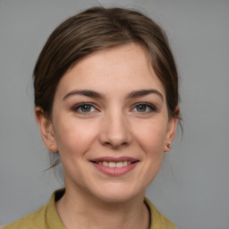
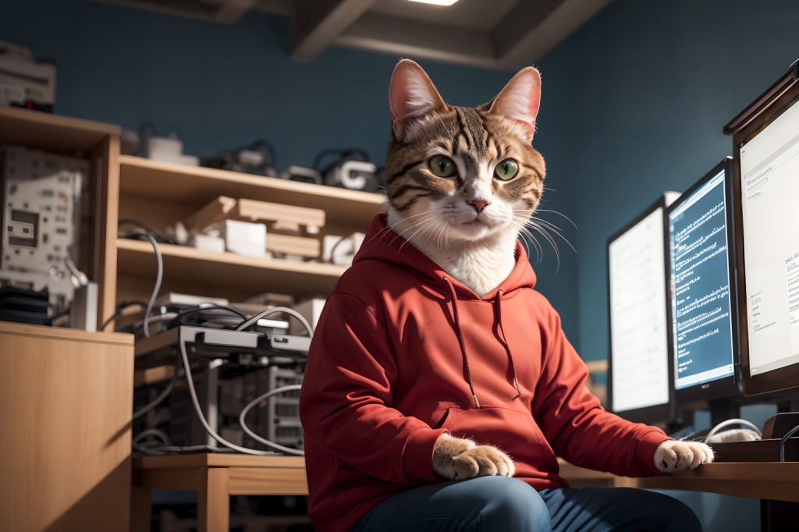
Have you recently been tricked by AI-generated content?
Notes:
I am sure many of us have been tricked by AI content in the past few years. It’s kind of everywhere right now and it’s become harder to detect.

Slide 2
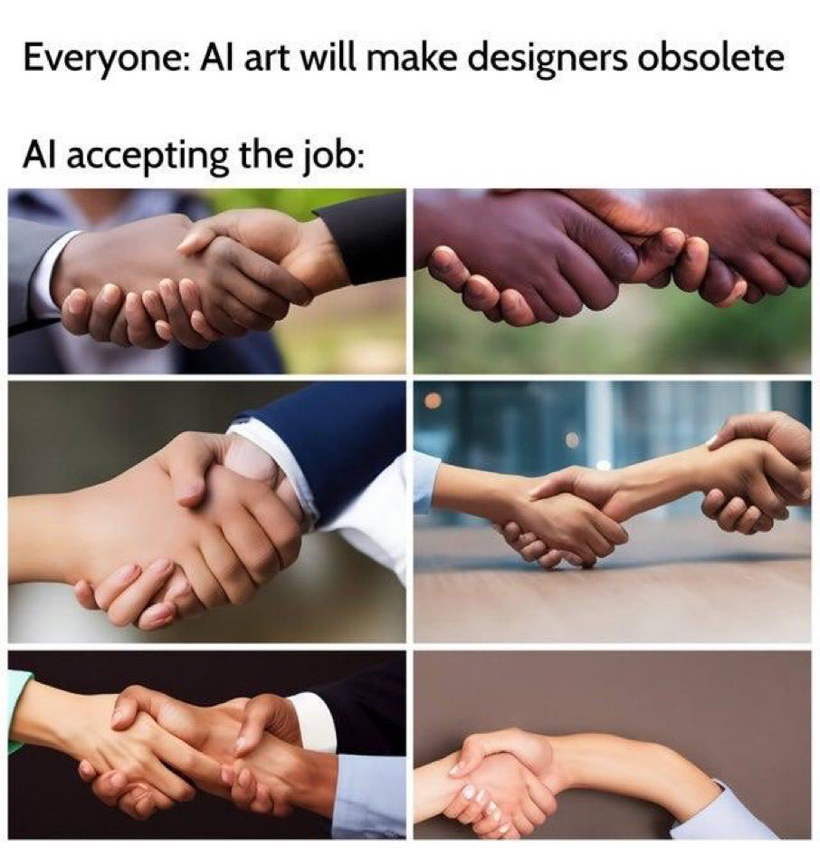
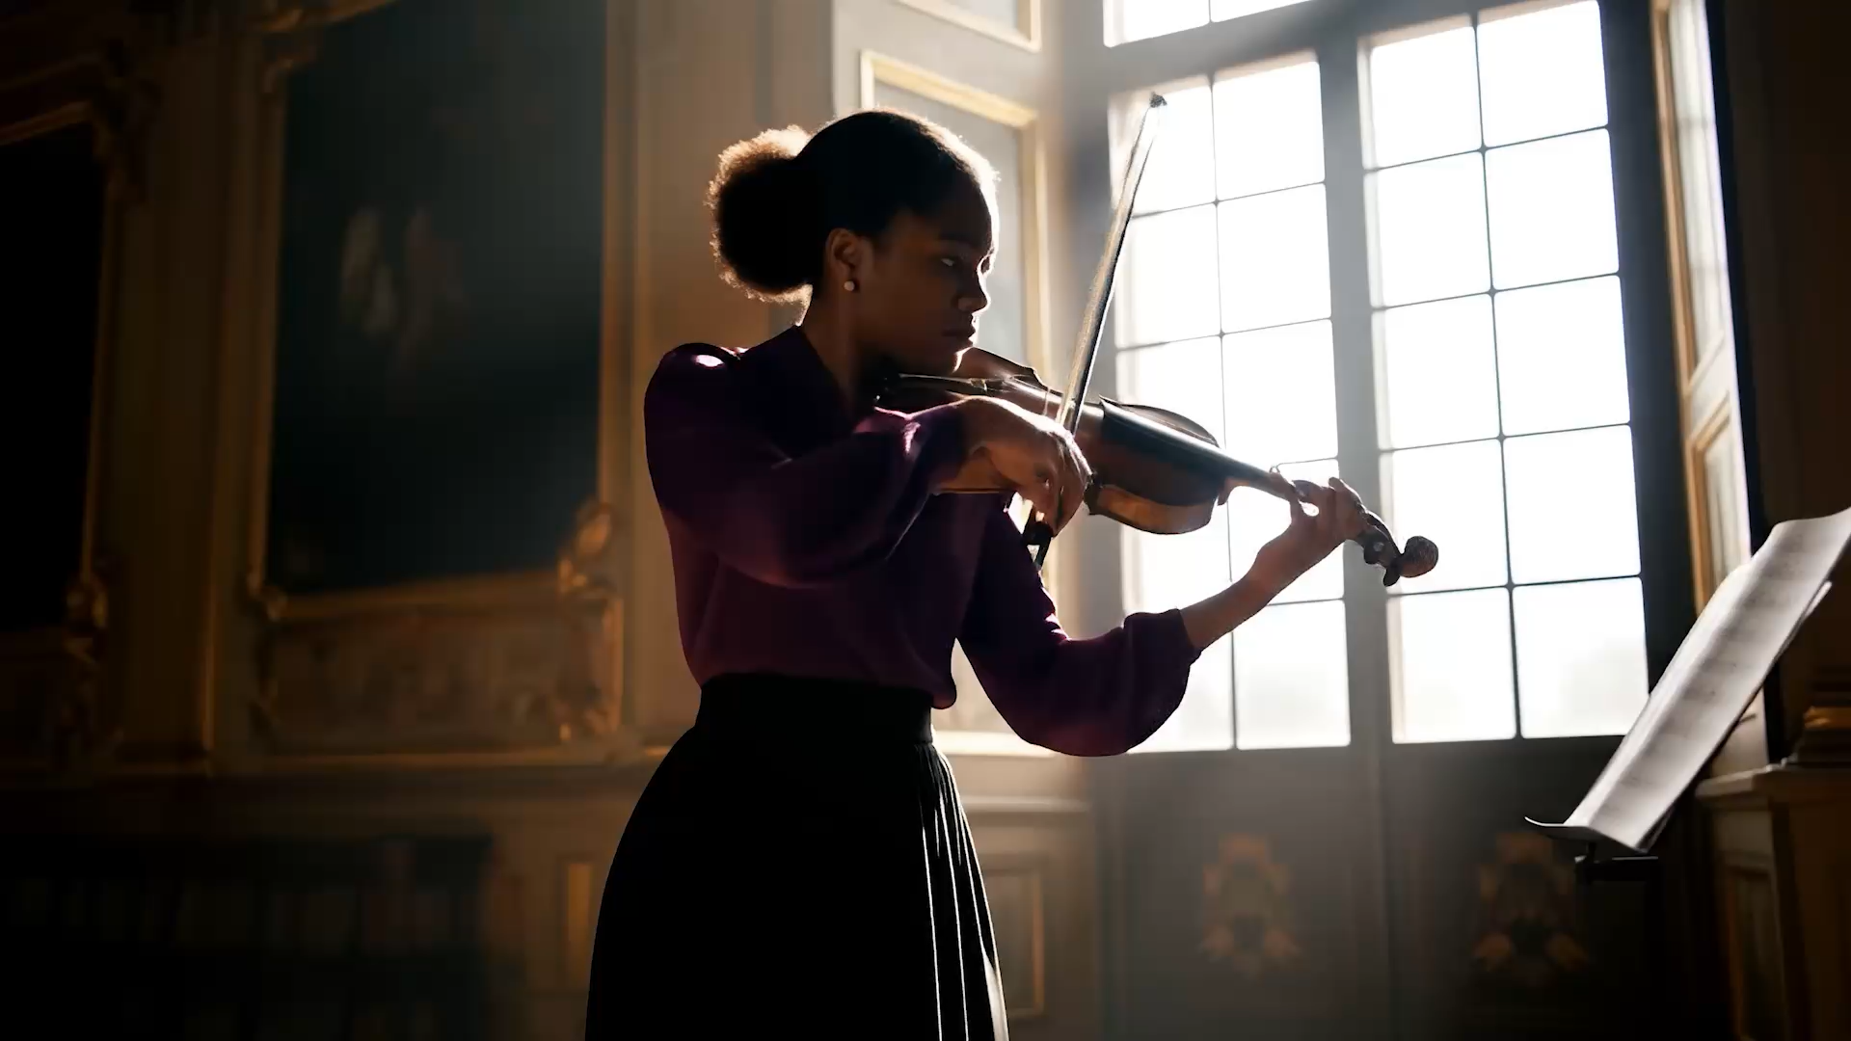
AI-Generated Content Improvements
2022-2025
Veo 3 (May 2025)
Notes:
Until recently, defects like distorted hands, extra fingers, and jumbled text made it easier to spot fakes. But these flaws are becoming less common, and even AI-generated videos now appear highly realistic, making AI content increasingly difficult to detect.
And this is amazing but it is also concerning because the average human can’t tell anymore what is fake what is real. This could lead to the spread of misinformation and it breaks our trust in the content we consume every day.

Slide 3
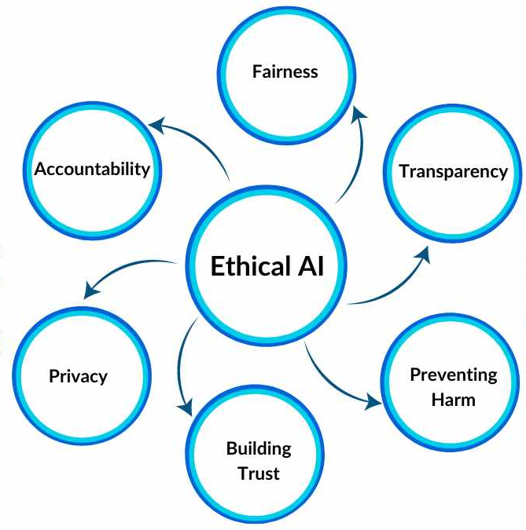
Risks
Misinformation
Fake News
Lack of Trust
Legal Concerns
Ethical Concerns
Political Manipulation
Notes:
This touches on the concept of Ethical AI, which includes transparency, or the need to label AI content as such.

Slide 4
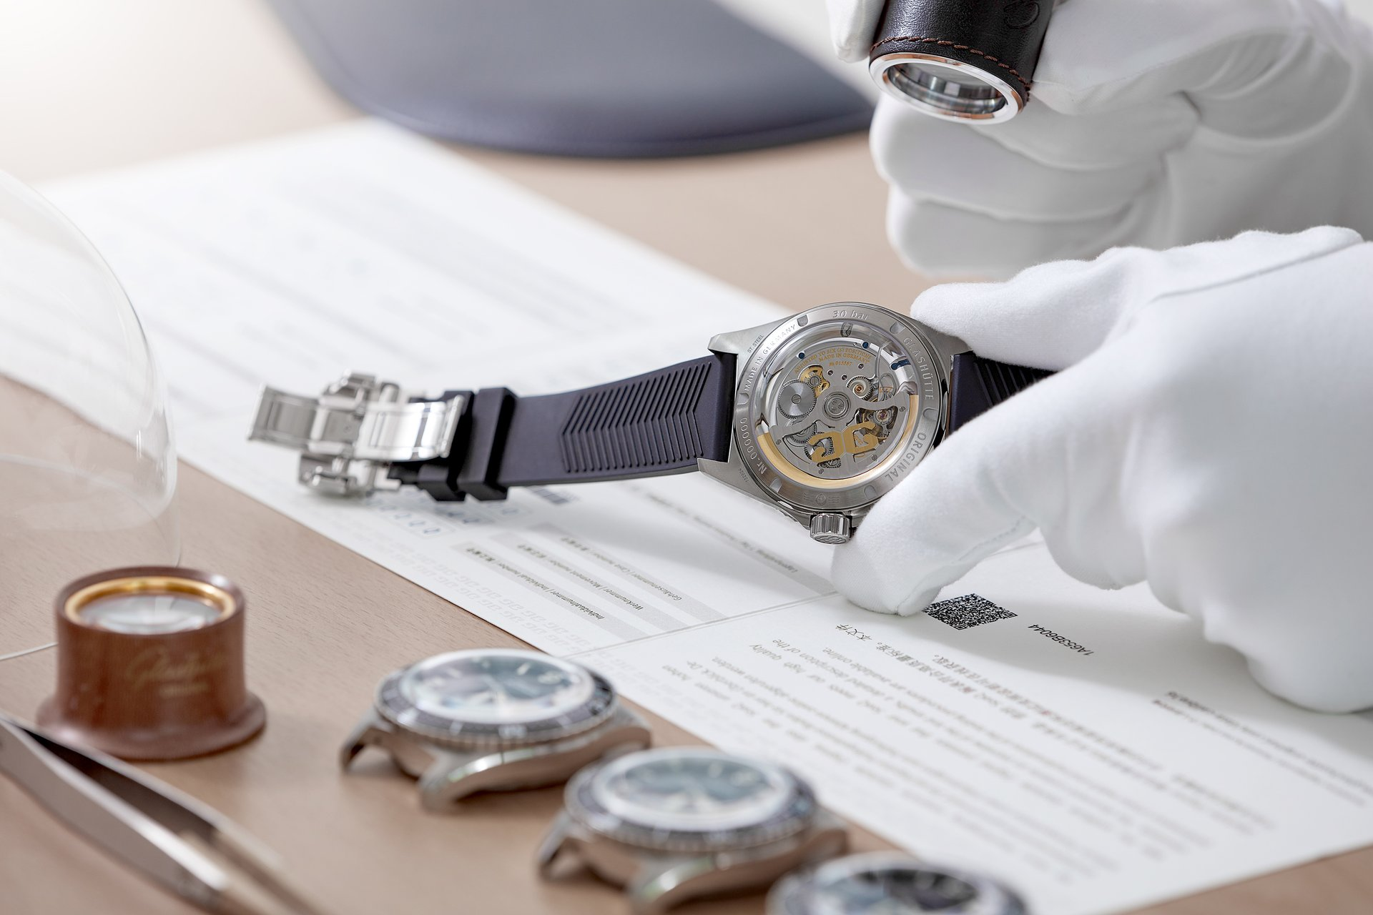
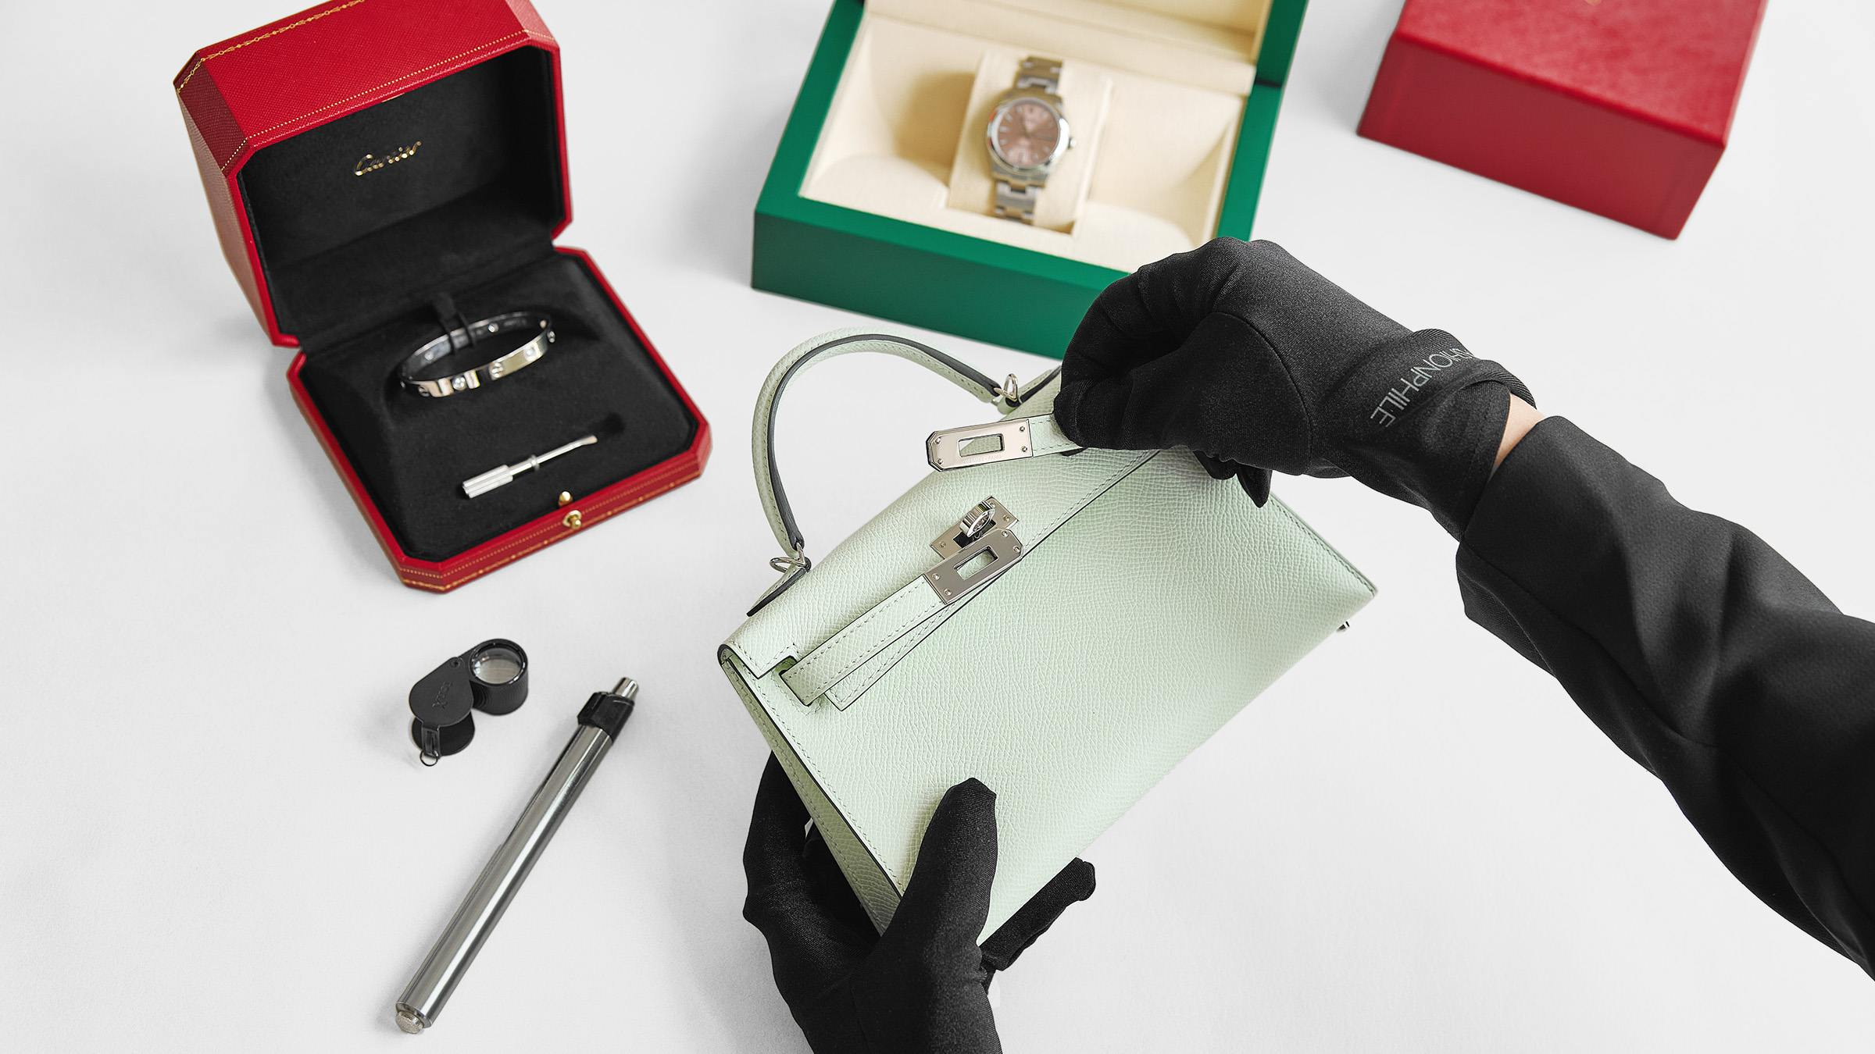
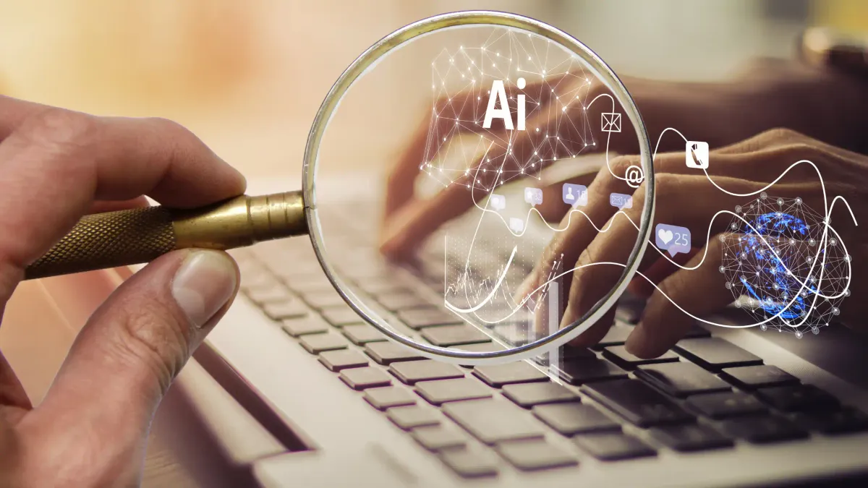
How to Detect Fake Vs Real?
Need specialized tools
Exposure to lots of data
Notes:
Just like authenticators who are able to spot fake luxury items through extensive exposure and specialized tools, we need something to detect fake images. And what better tool to detect AI than AI itself?

Slide 5
Detecting AI-Generated Images
Binary Classification: Real or Fake?
Notes:
So we need AI detection tools. Thankfully, there are some already out there. But I wanted to see if I can create something using the skills we learned in this class. So I have chosen this binary classification task for my project. My model aims to classify images as real or fake.

Slide 6
Data

Slide 7
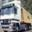
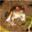
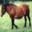
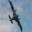


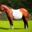

Dataset
Real (CIFAR10)
Source: Kaggle (CIFAKE Dataset)
Distribution: 120,000 images
50% from CIFAR-10
50% generated using Stable Diffusion on CIFAR-10
Fake (Stable Diffusion)
Notes:
To train my model, I used the CIFAKE dataset off of Kaggle which contains CIFAR-10 data as the real images and images generated using stable diffusion off of the CIFAR-10 data which are the fake images.
Controlled environment

Slide 8
Model Architecture

Slide 9
Model Architecture
Base Model
Optimizer
ResNet-18 trained from random weights
Adam
Binary Cross Entropy
Sigmoid (within Loss Function)
Loss Function
Activation Function
Early Stopping (patience = 3)
Data Augmentation
Regularization
Notes:
I used the ResNet-18 model trained from random weights with Adam optimizer, binary cross-entropy loss, and early stopping for regularization.

Slide 10
Performance

Slide 11
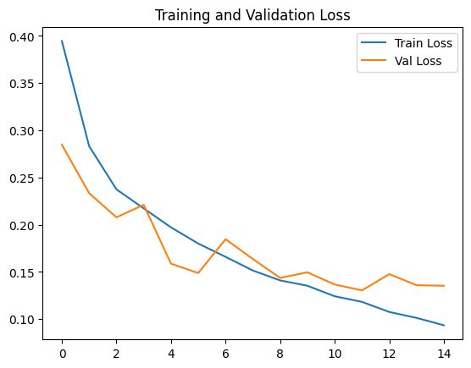
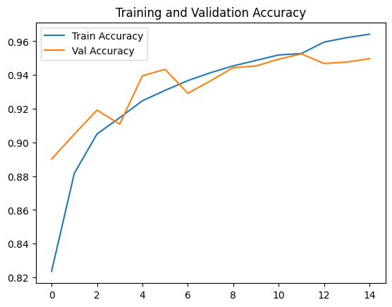
Performance
 | Train |  | Val |  | Test
(Lr, Batch Size) | Loss | Acc | Loss | Acc | Acc | Recall | Precision | F1 Score
(0.0005, 16) | 0.1183 | 95.27% | 0.1305 | 95.25% | 94.87% | 96.06% | 93.78% | 94.91%
Notes:
For performance, I did do some hyperparameter fine-tuning, specifically on the learning rate and batch size. The performance of the best hyperparameter combination is shown here. We can see some convergence and accuracy across training, validation, and test are around the 95% mark.
Representative
Zigzag could be due to
Smaller or more variable validation set
The gradient updates are tailored to the performance on the training set, so no gradient updates on validation
Early on the model is still underfitting so with the validation set it might have been a hit or miss with each gradient update
Validation did better early on because
The validation sample could have by chance been just easier to classify and not a good representation of all the data
Other thing is that while the training set has some data augmentation done to it, the validation set is clean, so the training set is even harder to model at the beginning

Slide 12
Interpretation

Slide 13
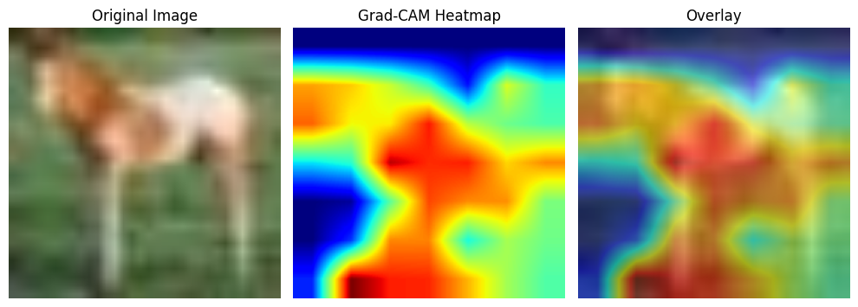
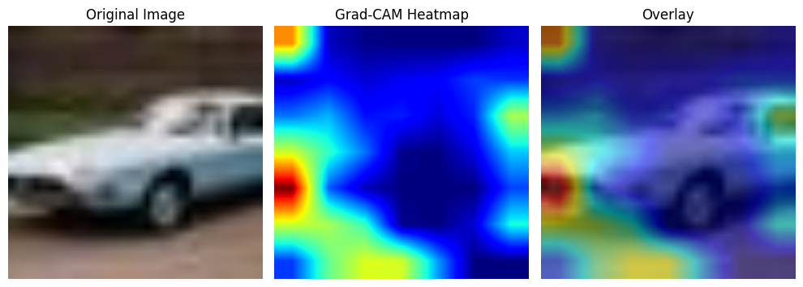
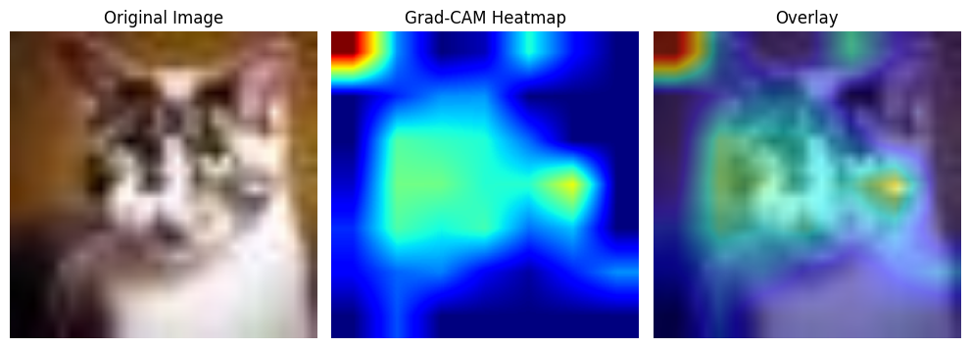
Grad-CAM on Real Image
Grad-CAM on Synthetic Image
Grad-CAM on Synthetic Image
Notes:
For interpretation, I thought I would include some Grad-CAM heatmaps to showcase a few interesting observations. So generally, with grad-cam, the areas in dark red contribute most to the decision of the model.
And we see that for the real image at the top, most of the image is useful for classification as seen by the amount of red in the picture.
While for fake images, only specific parts of the image seem to be useful, probably areas more likely to present glitches
For the synthetic car, the radiator grill pattern seems to be most useful or it could be due to some flaws in the license plate which does tend to happen
And then for other fake images like the cat here, the focus is not even the main object but a corner in the background

Slide 14
Limitations & Improvements

Slide 15
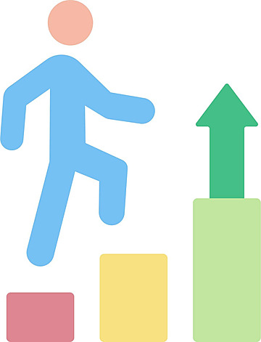
Limitation and Improvement
Limitation: Does not generalize well to other AI-generated images we see everyday.
Improvement: Increase the diversity of image sizes/resolutions and include images from other image generation methods.
Notes:
One improvement could be to increase the diversity of images in the data because the model currently doesn’t generalize well to higher resolution images since it was trained on 32x32 images.

Slide 16
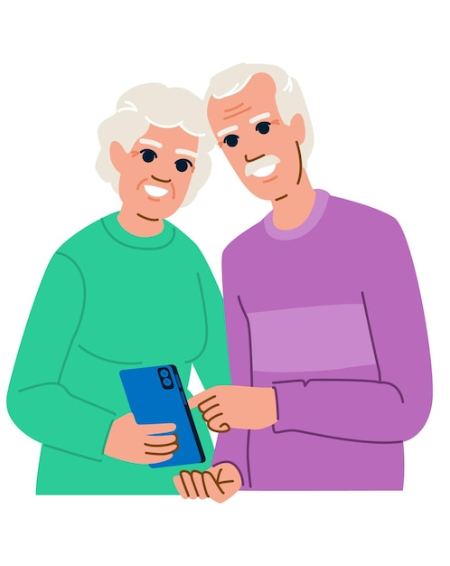
Final Takeaway:
Stop making fun of your parents for falling for fake Facebook and WhatsApp posts, because we are already on the same track.

Slide 17
Appendix
Notes:
Mention domain shift.

Slide 18
Stable Diffusion and Model Hierarchy
Stable Diffusion
Latent Diffusion
creates highly realistic images from just a text prompt
Diffusion but in a compressed space (instead of pixel space)
Diffusion
Generative
create images, text, etc.
add noise then reverse the process to generate new realistic images.
Notes:
Stable Diffusion is a model that generates images from text prompts.

Slide 19
Domain Mismatch/Shift
ChatGPT
ChatGPT was unable to classify real images well. It predicted all real samples as fake due to the pixelated blurred look.
This is because it was not trained on such low-resolution images.
Comparing Model Performance Against
I attempted to use my model on a few higher resolution photos
But downscaling those images resulted in blurry/smooth photos that depicted fake images, so everything was classified as fake.
Higher Res Images
Notes:
I have tried to compare my model to ChatGPT and see whether chatgpt can identify fake images better, but it seems like it was not trained on low-resolution images like these so it didn’t work out very well.
On another note, I tried running my model on a few higher resolution photos and that also didn’t work out well because the image is transformed and downscaled in a way that makes the image blurry or smoothed out which is associated with AI images.
So those 2 limitations are examples of domain mismatch because each of these models were trained on a specific set of data but the tested on a data format that it’s not familiar with.

Slide 20
Performance
 | Train |  | Val |  | Test
(Lr, Batch Size) | Loss | Acc | Loss | Acc | Acc | Recall | Precision | F1 Score
(0.001, 16) | 0.18 | 93% | 0.17 | 93% | 94% | 95% | 93% | 94%
(0.001, 32) | 0.14 | 94% | 0.15 | 94% | 94% | 94% | 94% | 94%
(0.0005, 16) | 0.12 | 95% | 0.13 | 95% | 95% | 96% | 94% | 95%
(0.0005, 32) | 0.11 | 96% | 0.12 | 95% | 95% | 95% | 95% | 95%
(0.0001, 16) | 0.09 | 97% | 0.16 | 94% | 94% | 94% | 94% | 94%
(0.0001, 32) | 0.15 | 94% | 0.18 | 93% | 94% | 94% | 93% | 93%
Notes:
I fine-tuned 2 hyperparameters. The learning rate and the batch size. The results were good overall with learning rate of 0.0005 performing best. I chose to go with a learning rate of 0.0005 due to low val loss and batch size of 16 due to better loss stabilization/convergence.

